Slide 1
How to improve the accuracy of clustering algorithms
Denisenko Sofiia 狄 苏菲 1820249051

Slide 2
Task
Clustering is an important data analysis technique. However, due to the diversity of datasets, each clustering algorithm is unable to produce satisfactory results on some particular datasets. In this paper, we propose a clustering optimization method called HIAC (Highly Improving the Accuracy of Clustering algorithms). By introducing gravitation, HIAC forces objects in the dataset to move towards similar objects, making the ameliorated dataset more friendly to clustering algorithms (i.e., clustering algorithms can produce more accurate results on the ameliorated dataset).
Assignment: Read the paper; Redo the experiment; Present your mastering contents in a ppt file.

Slide 3
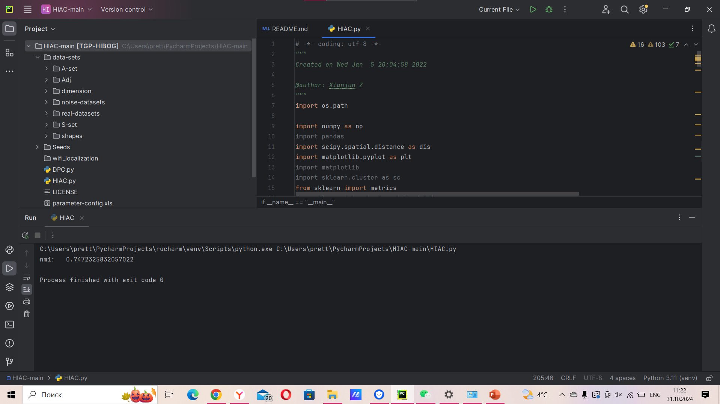
Running code in PyCharm

Slide 4
Code
The code implements a two-step approach to clustering:
HIAC: A hierarchical iterative approach for ameliorating the dataset by moving points closer to their neighbors.
DPC: The DPC algorithm is used to perform the final clustering on the improved dataset.
The NMI score is used to evaluate the clustering quality.

Slide 5
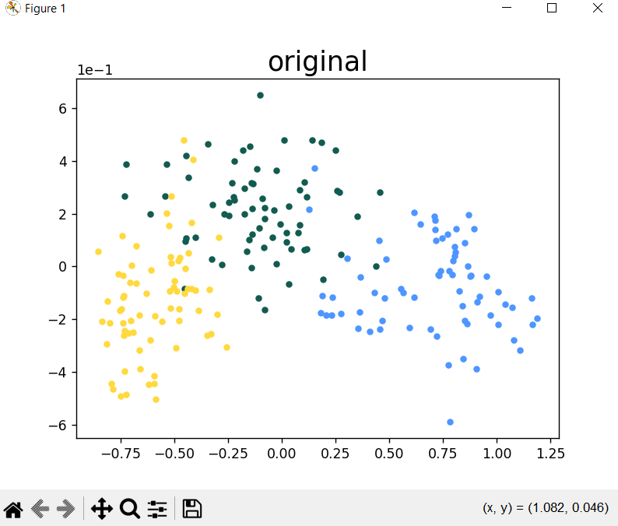
Output

Slide 6
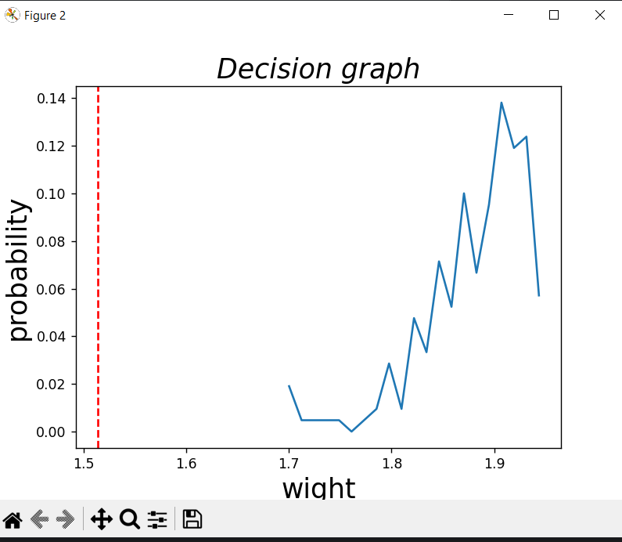
Output

Slide 7
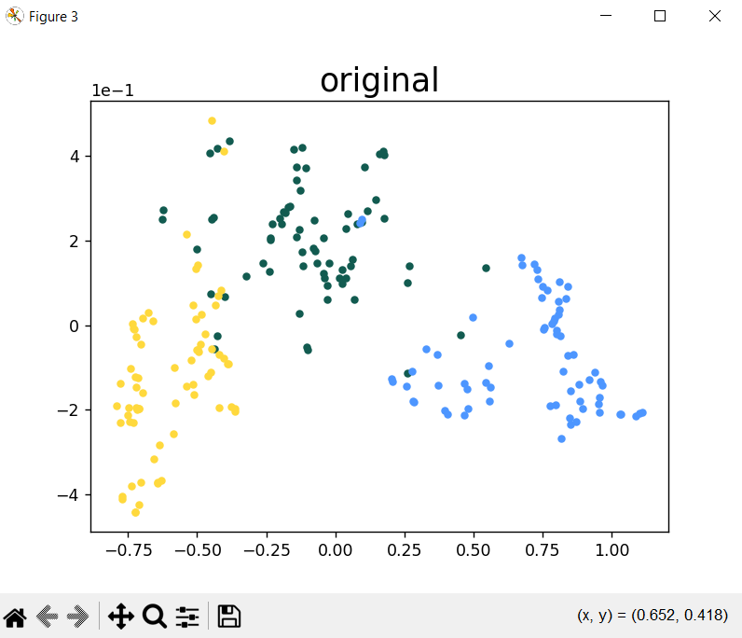
Output

Slide 8
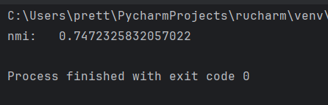
Output

Slide 9
Explanations
The decision graph visualizes the weight distribution of neighbors, helping to identify a suitable threshold for pruning.
The plots show the original dataset, the dataset after PCA (if applicable), and the dataset after the HIAC amelioration process.
The NMI score indicates how well the DPC clustering aligns with the ground truth labels. A higher NMI score generally indicates better clustering performance.
Resulting NMI of 0.74 is closer to 1, suggesting a good level of agreement. This means the clustering algorithm has successfully identified clusters that are reasonably similar to the true clusters.

Slide 10
References:
https://lexue.bit.edu.cn/pluginfile.php/690911/mod_assign/introattachment/0/how%20to%20improve%20the%20accuracy%20of%20clustering%20algorithms.pdf?forcedownload=1 - How to improve the accuracy of clustering algorithms Qi Li , Shuliang Wang * , Xianjun Zeng , Boxiang Zhao , Yingxu Dang
https://github.com/qiqi12/HIAC - code

